Slide 1
COMPUTER FUNDAMENTALS
.
A 1.2. Representing Data

Slide 2
A 1.2.1 -A1.2.2
Inquiry Statement :
Describe the principal methods of representing data. - Explain how binary is used to store data.
Skills:
Explain the concept of different number systems (binary, hexadecimal, decimal) and their significance in computing.
Identify the base of each number system and the range of digits used.
Explain the relationship between place values and powers of the base in each number system.
Integer Representation:
Represent positive integers in binary and hexadecimal notation.
Explain how the place value system works in binary and hexadecimal to represent different magnitudes.
ATL Skills:
Thinking: Apply critical thinking skills to analyze and solve conversion problems between different number systems.
Communication: Communicate effectively by clearly representing numbers in different notations and explaining conversion processes

Slide 3



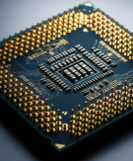

Do Now Activity (5 mins)
Identify the and explain the
Components of Computer
TOK
To what extent can data manipulation be considered an objective process when human judgment influences how databases are designed and interpreted?
Success Criteria:
Explain the concept of different number systems (binary, hexadecimal, decimal) and their significance in computing.
Identify the base of each number system and the range of digits used.
Explain the relationship between place values and powers of the base in each number system.
Learning Intention:
Describe the principal methods of representing data. - Explain how binary is used to store data.

Slide 4
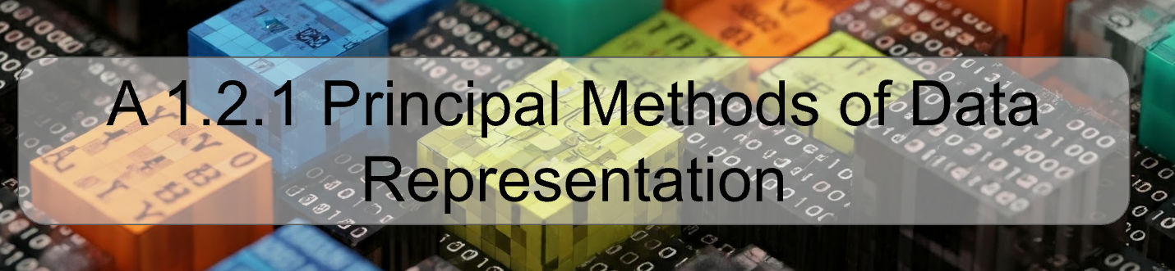

Slide 5


Slide 6
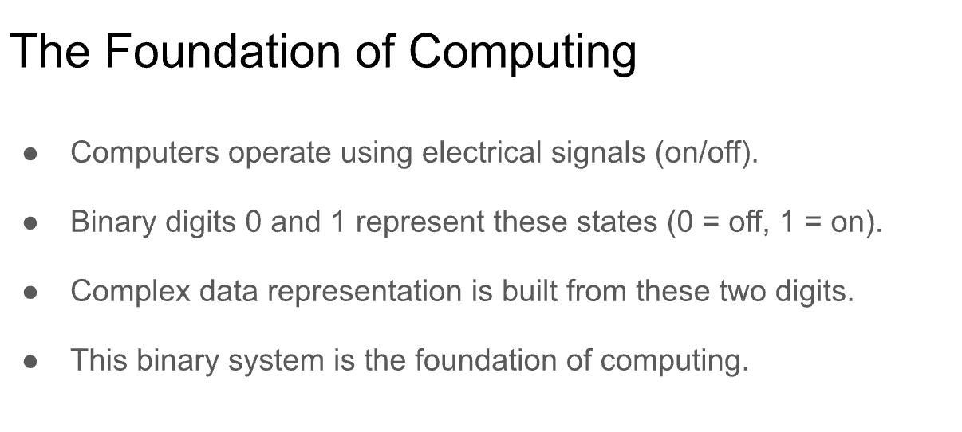

Slide 7
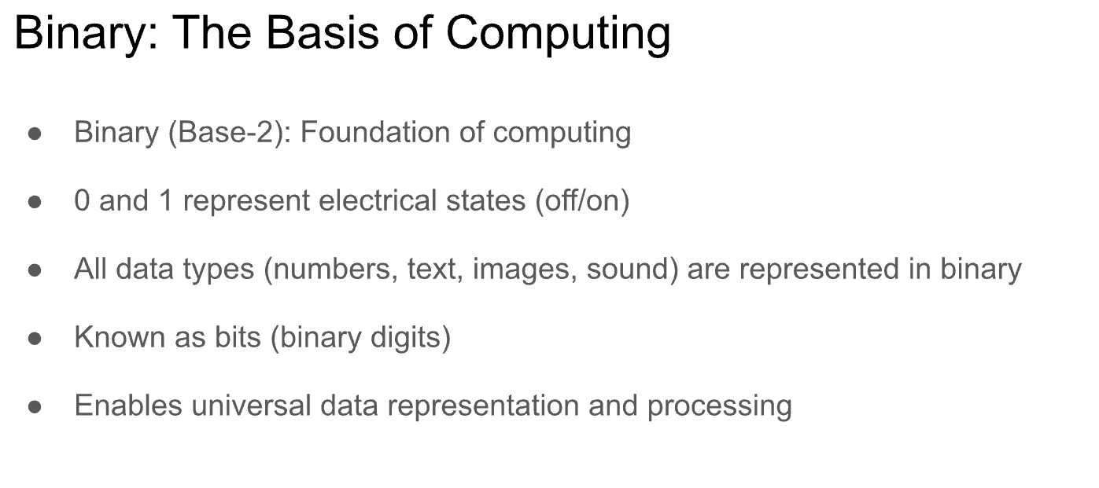

Slide 8
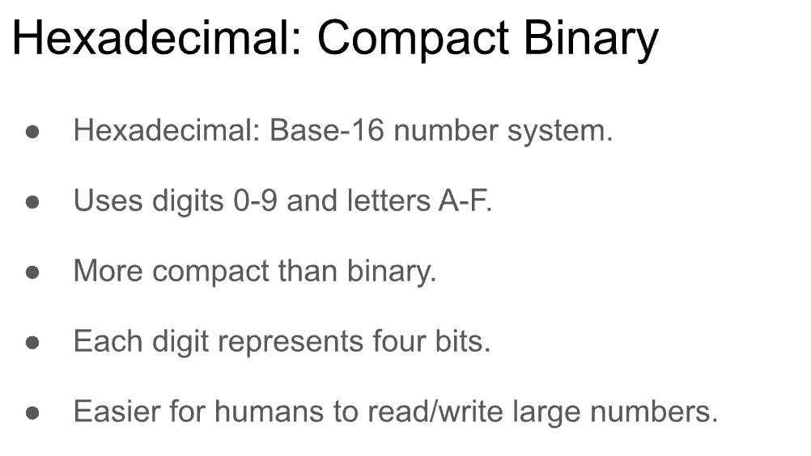

Slide 9
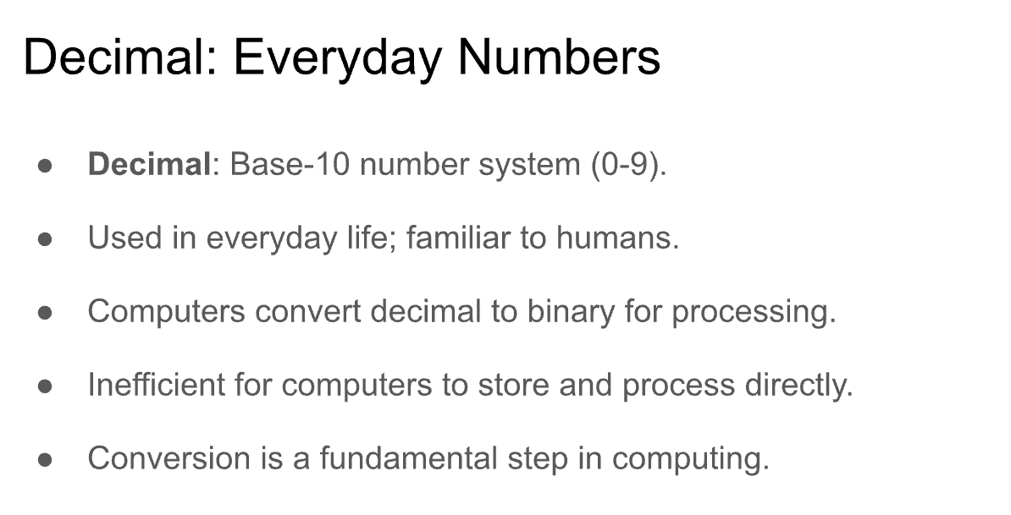

Slide 10
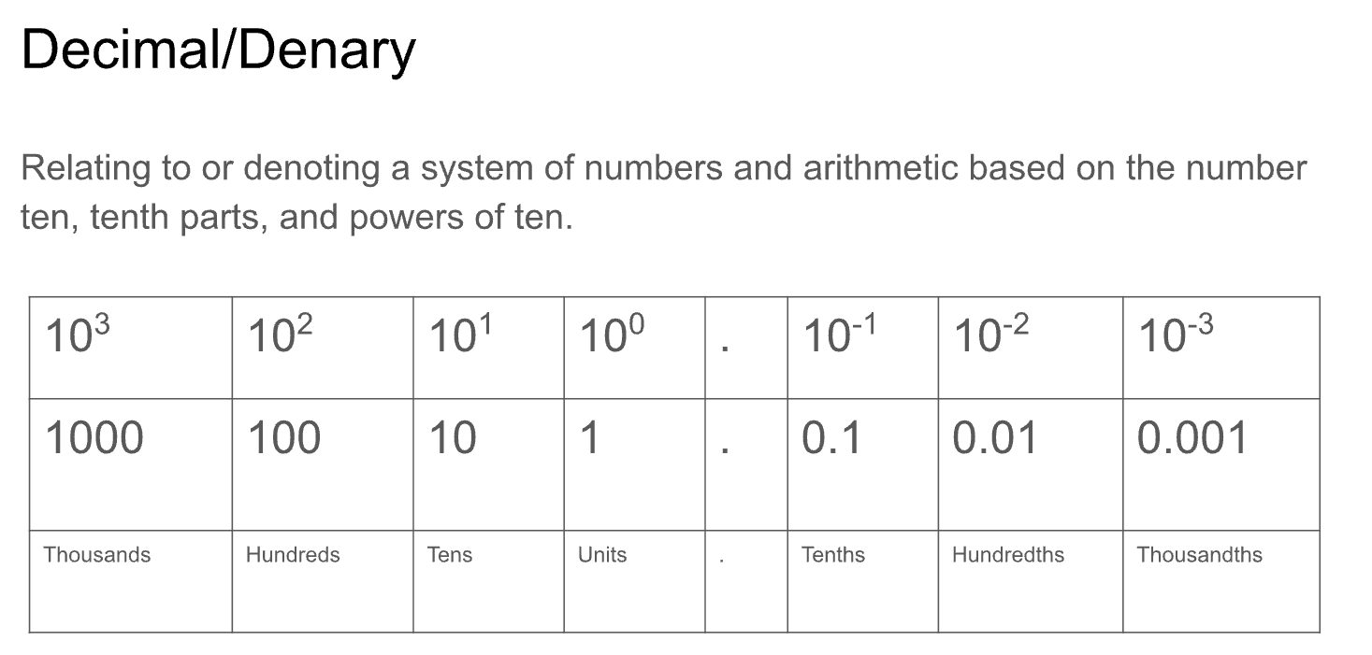

Slide 11
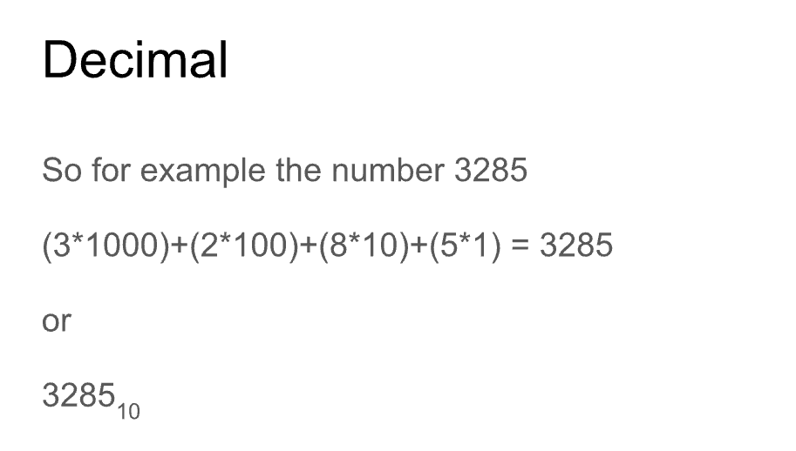

Slide 12
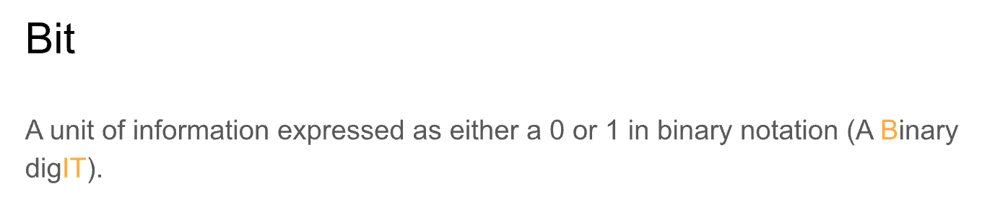

Slide 13
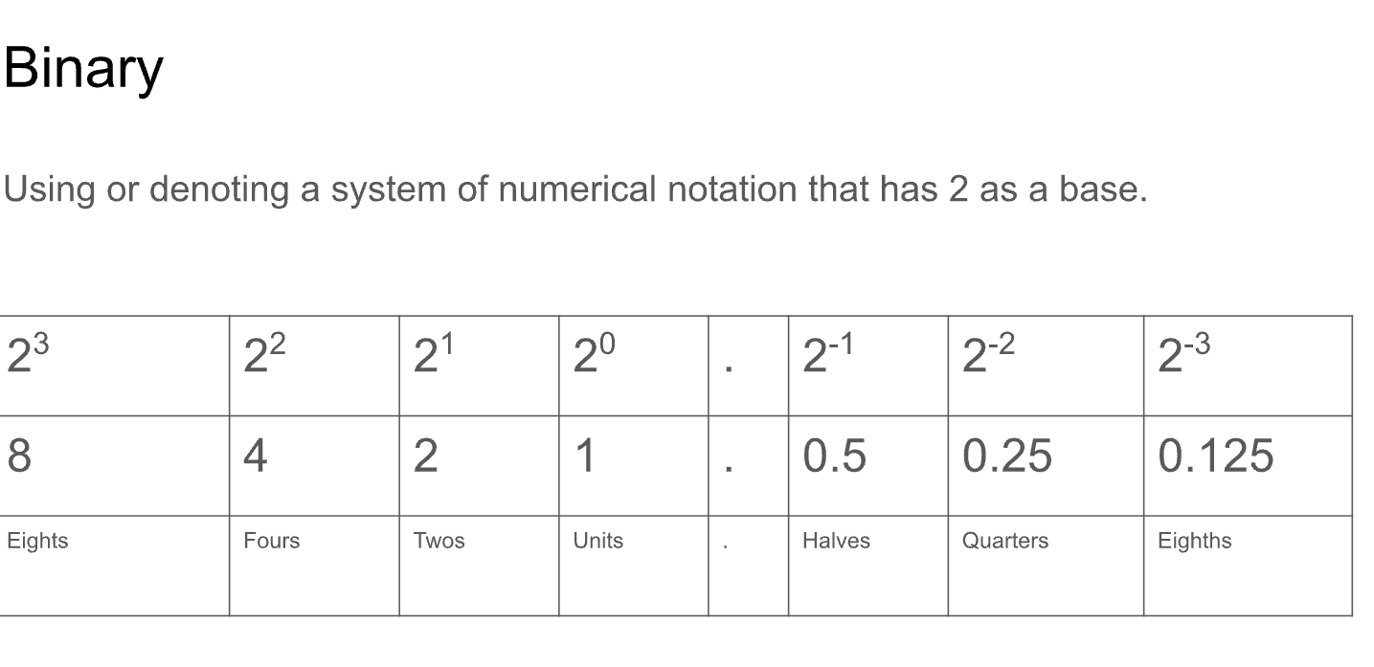

Slide 14
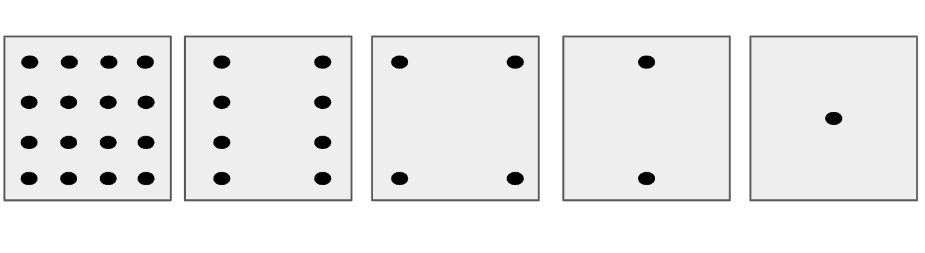

Slide 15
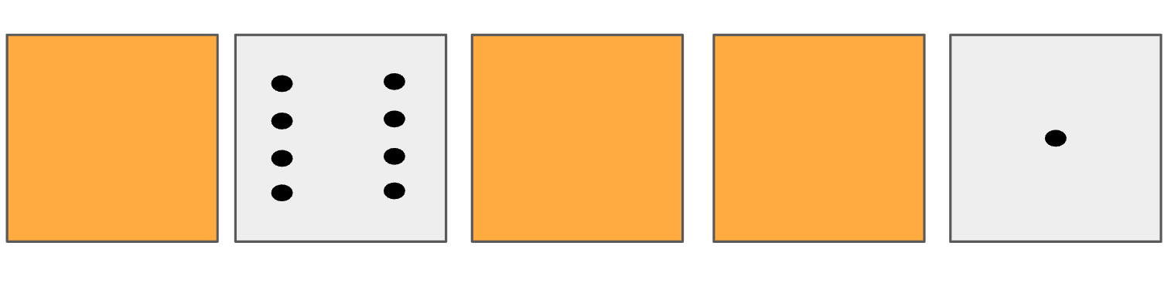

Slide 16
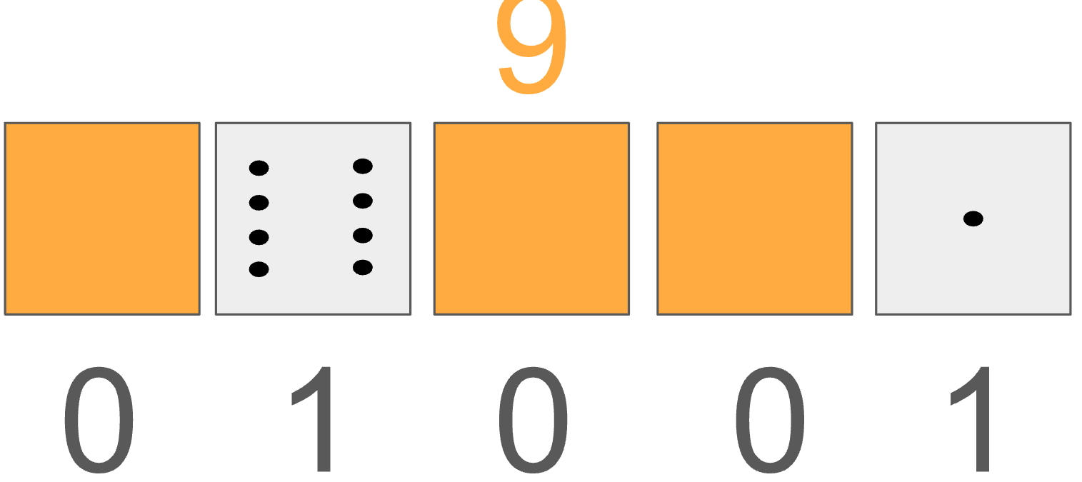

Slide 17


Slide 18
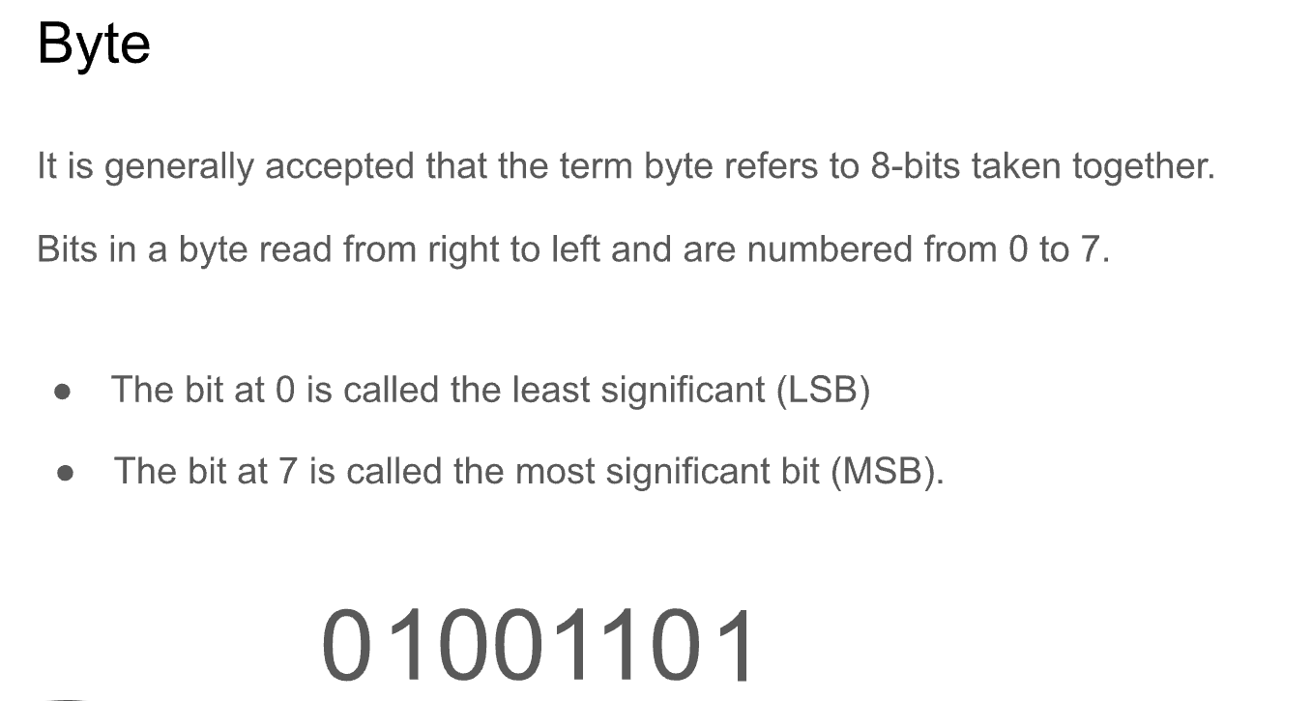

Slide 19
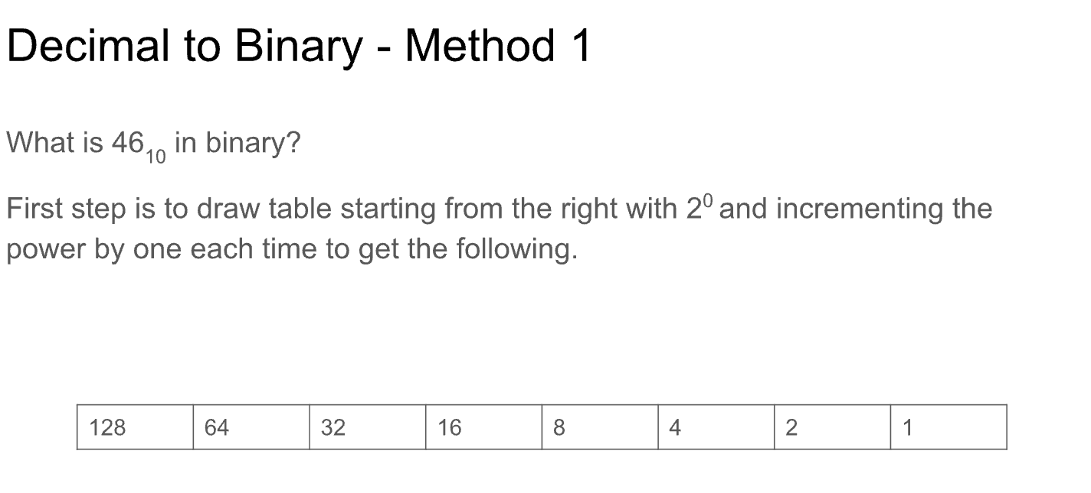

Slide 20
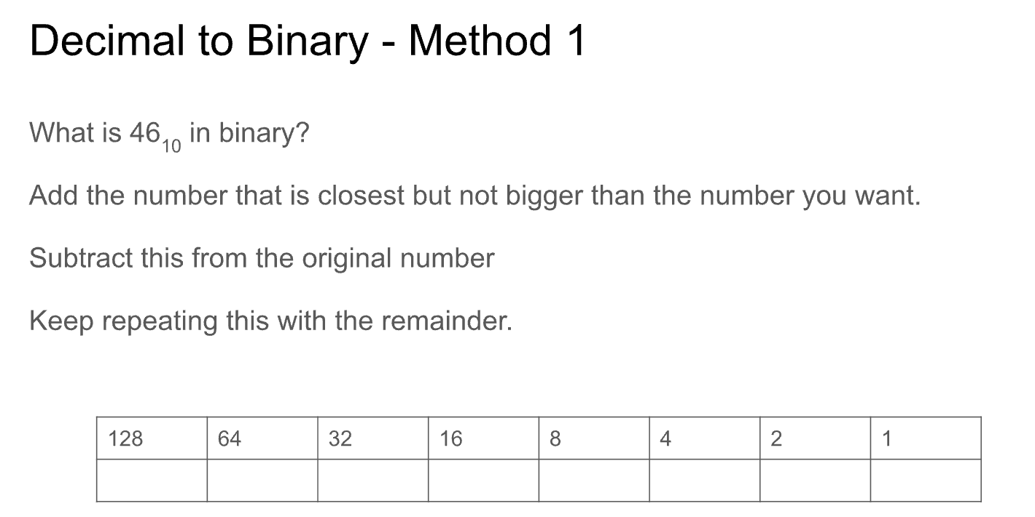

Slide 21
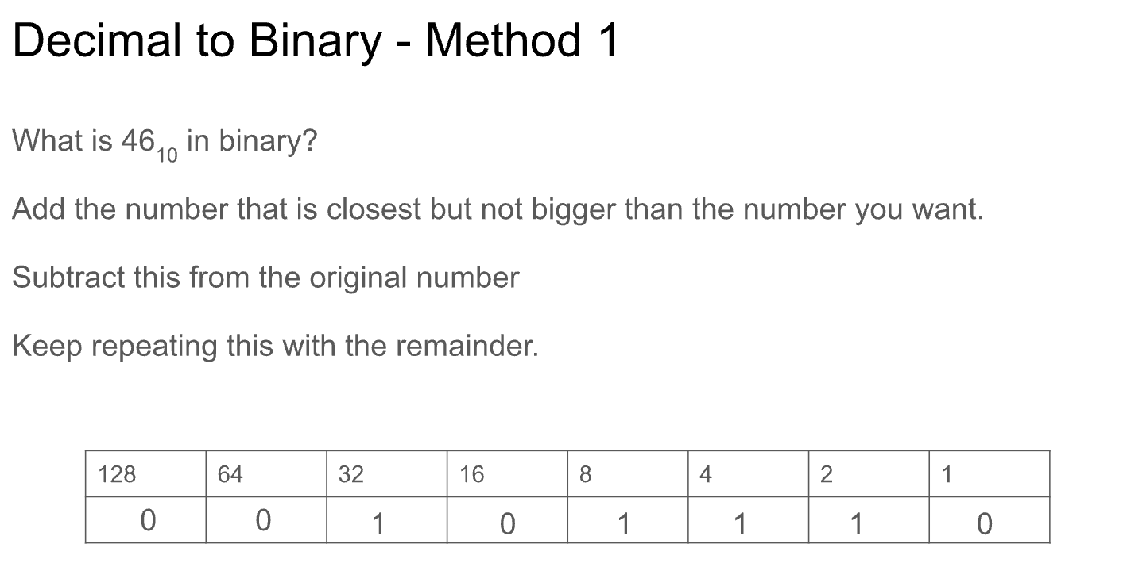

Slide 22
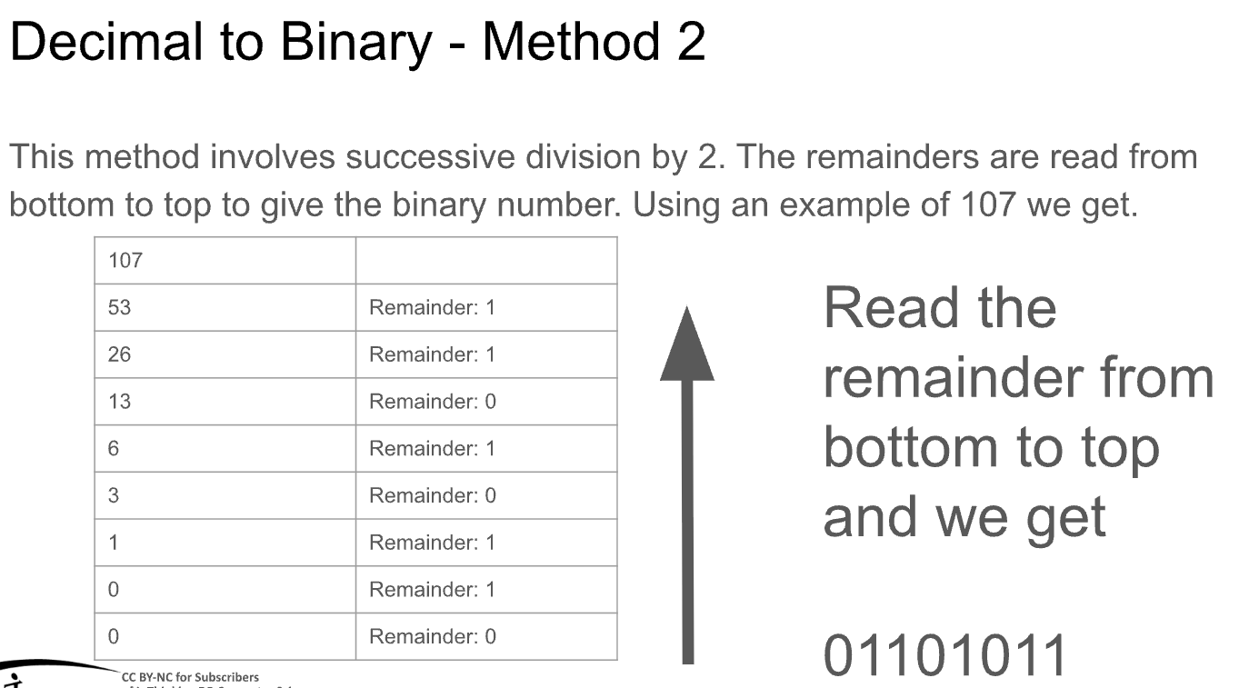

Slide 23
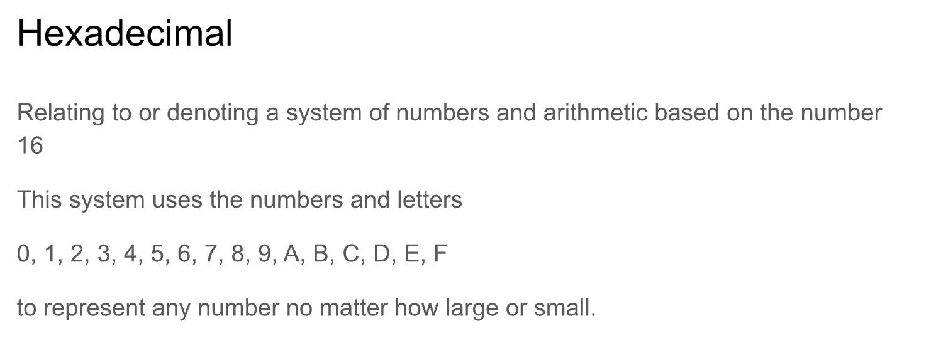

Slide 24
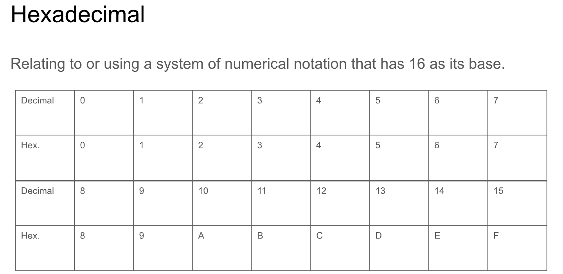

Slide 25
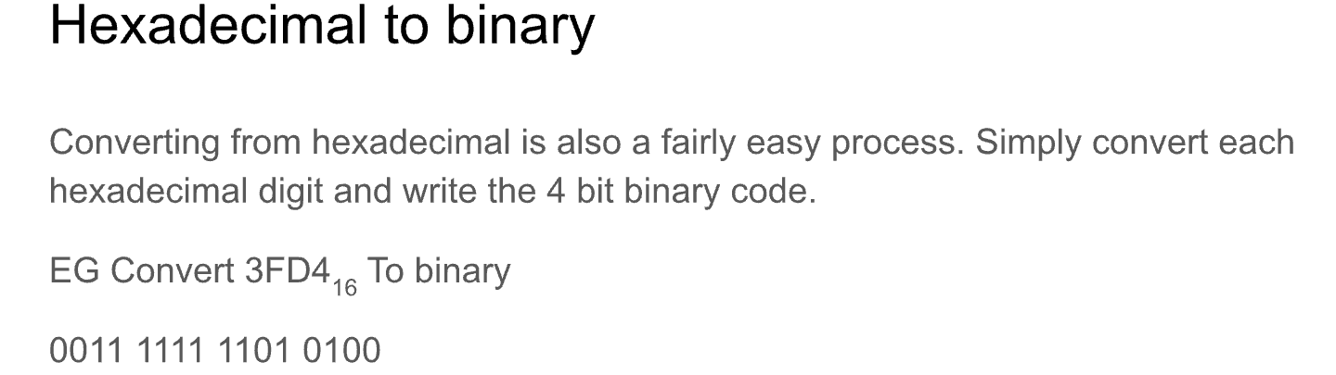

Slide 26
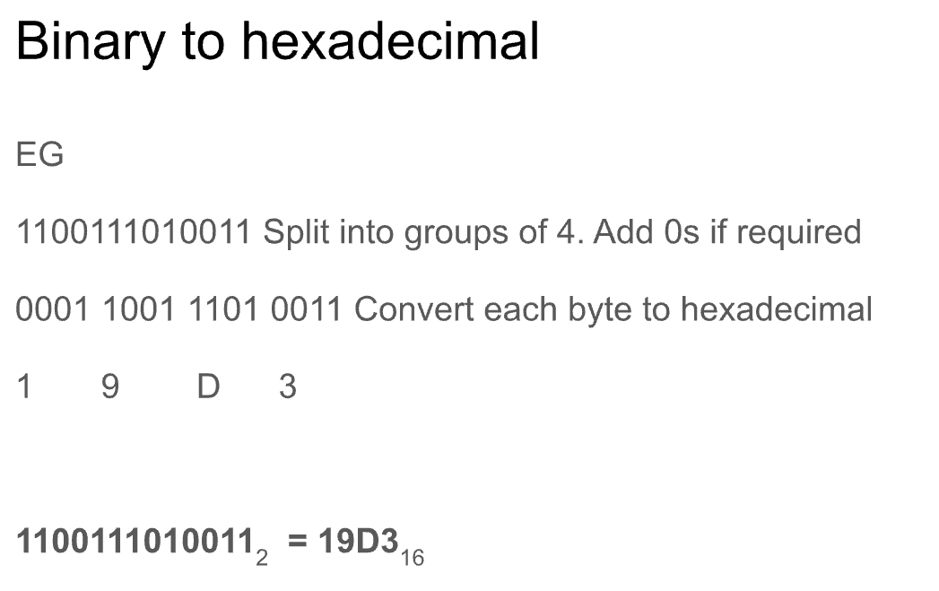

Slide 27
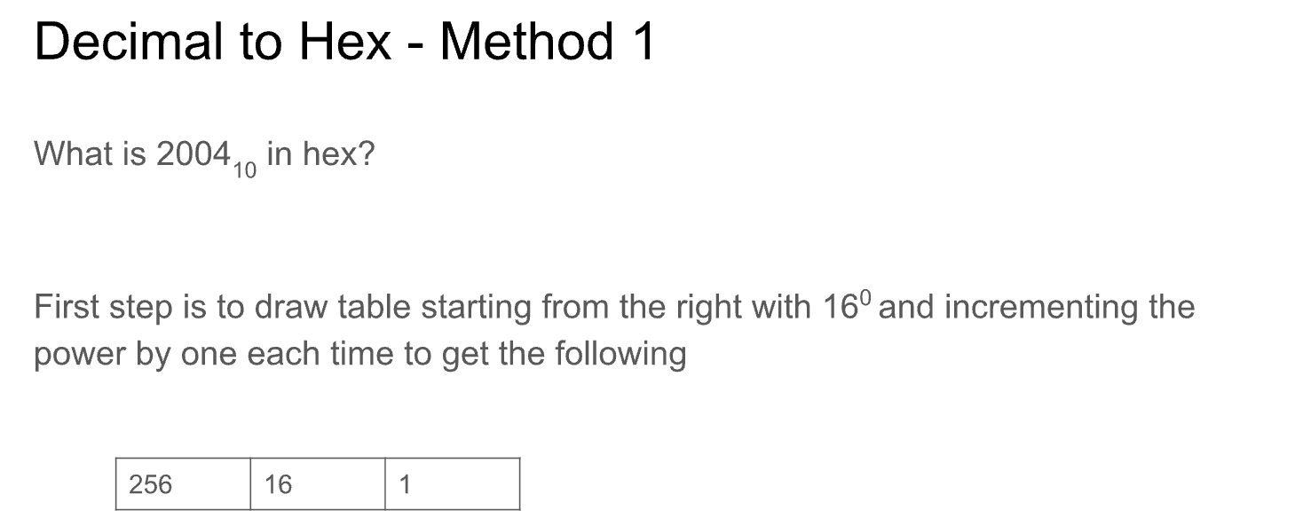

Slide 28
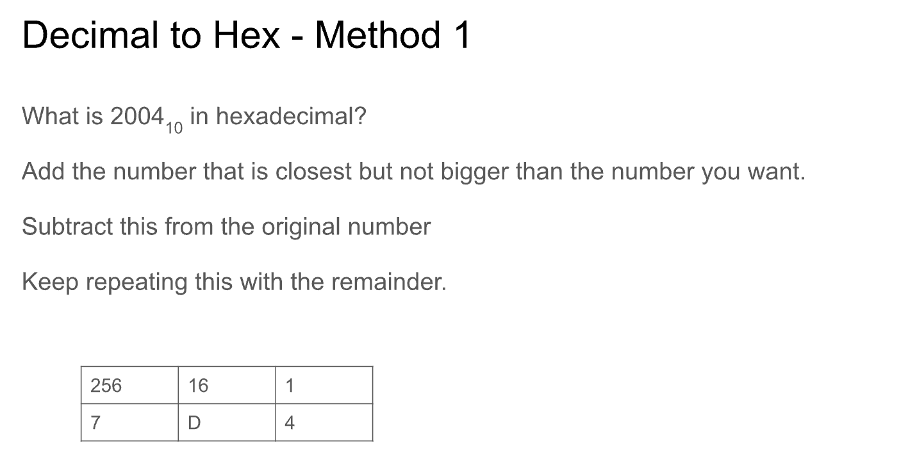

Slide 29
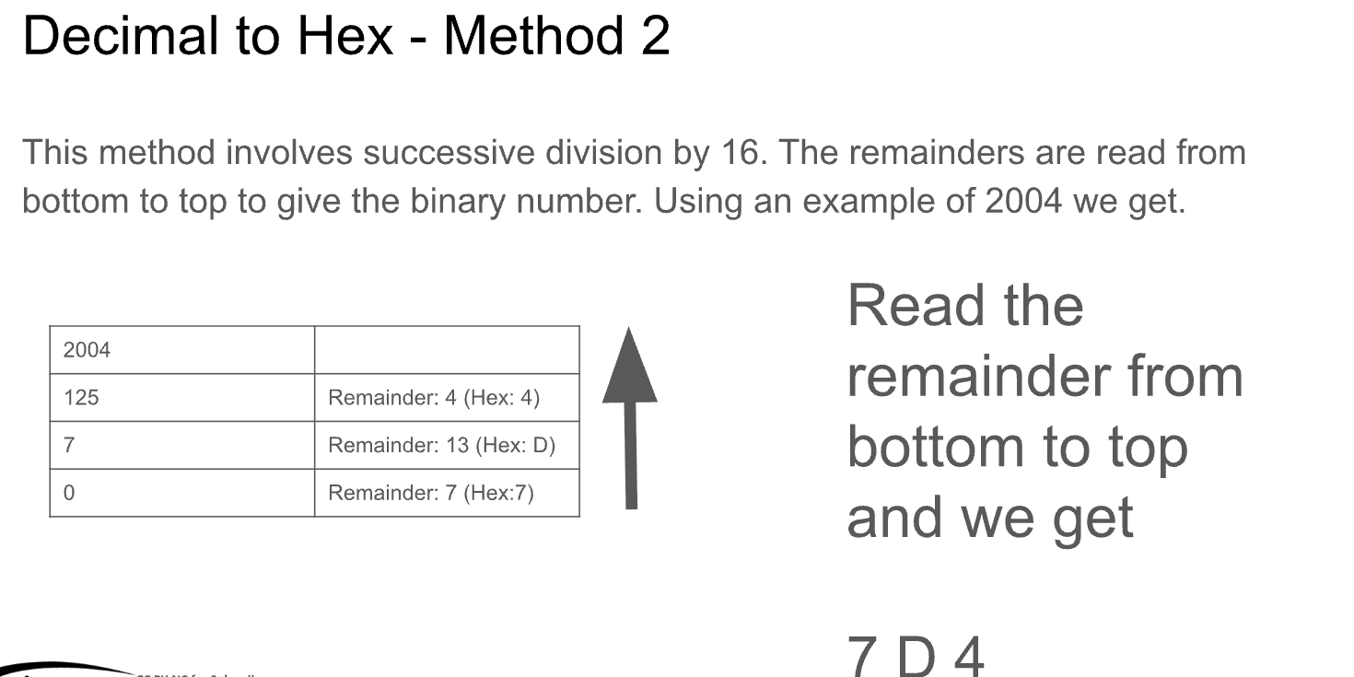

Slide 30
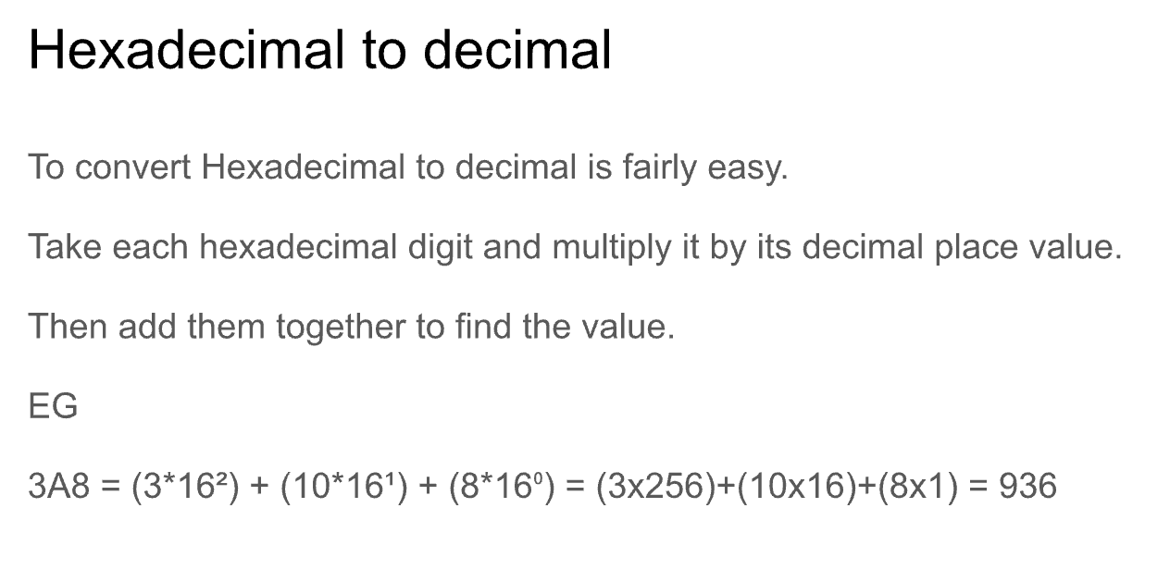

Slide 31
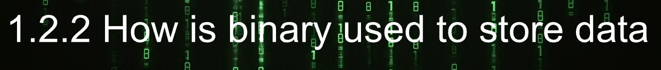

Slide 32
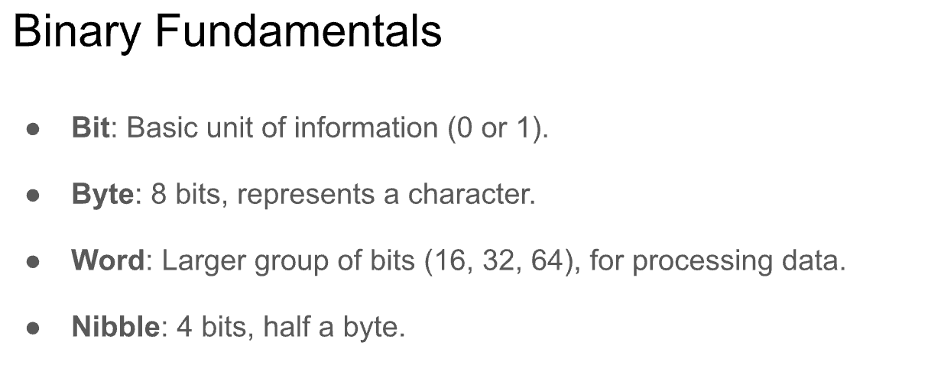

Slide 33
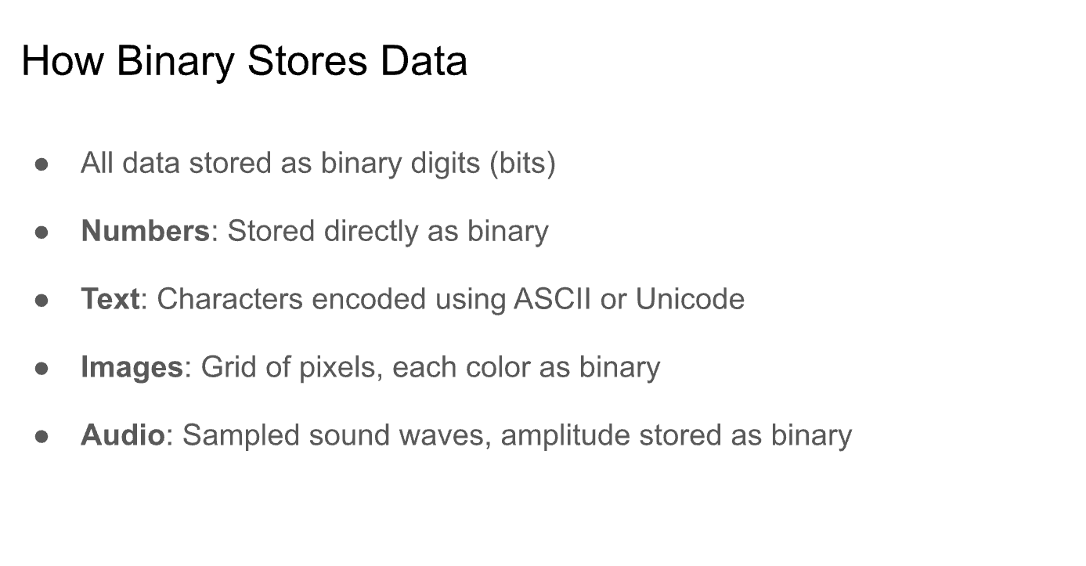

Slide 34
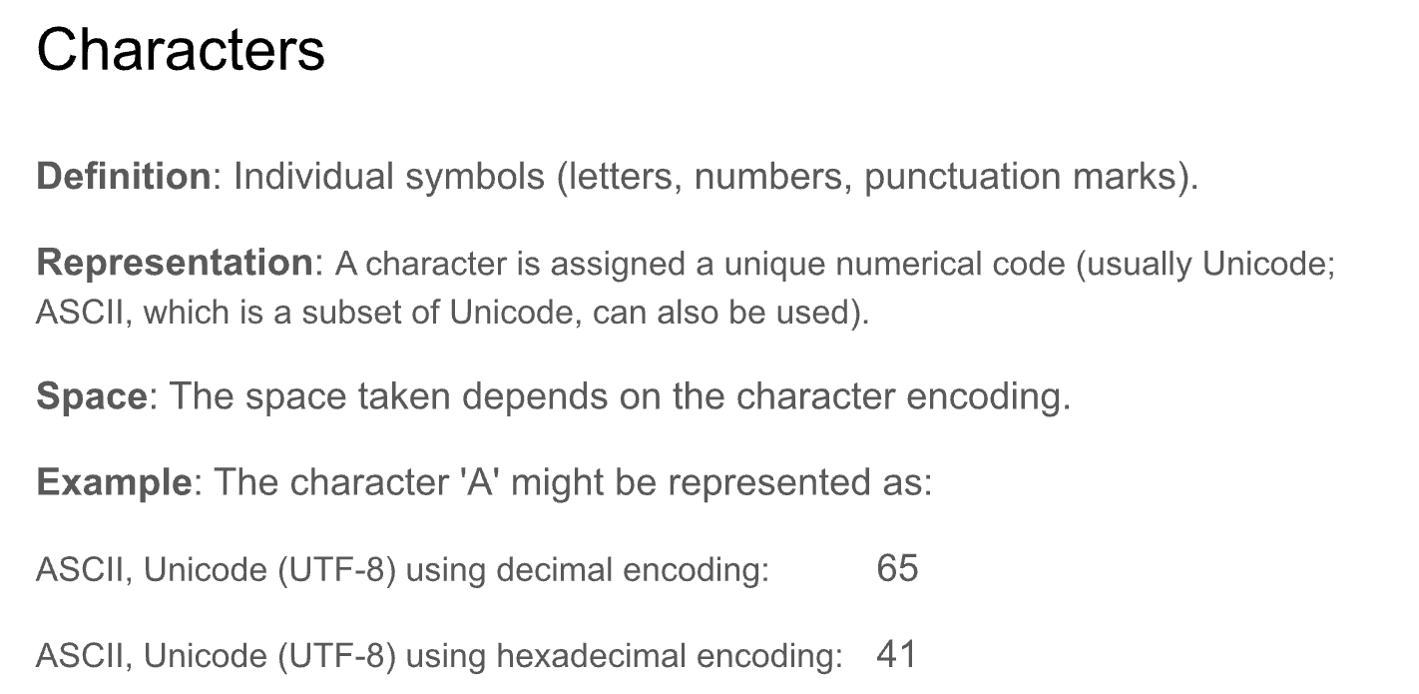

Slide 35
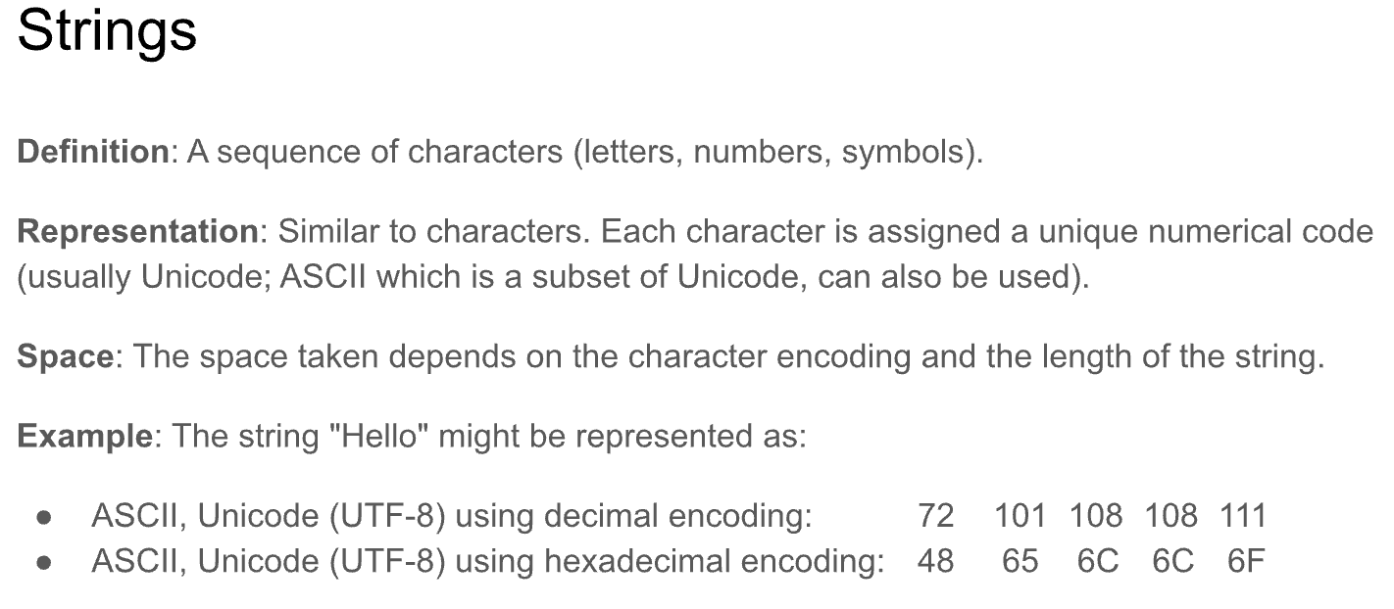

Slide 36
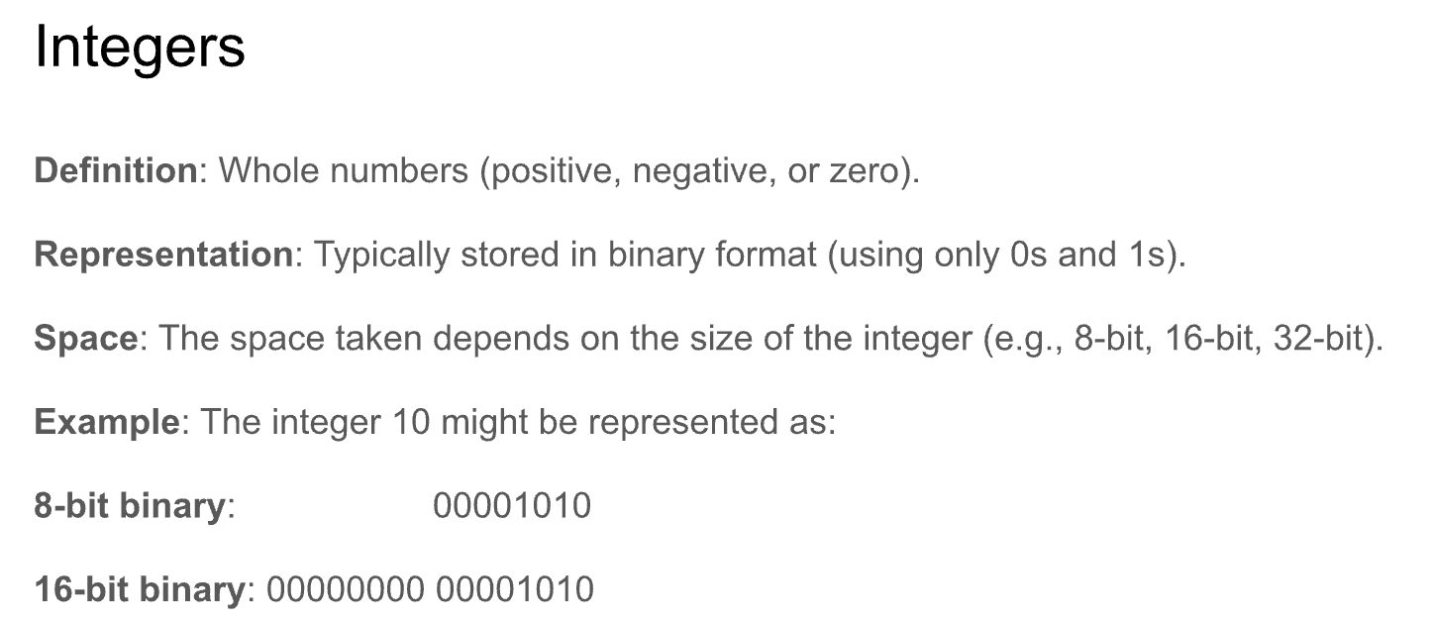

Slide 37
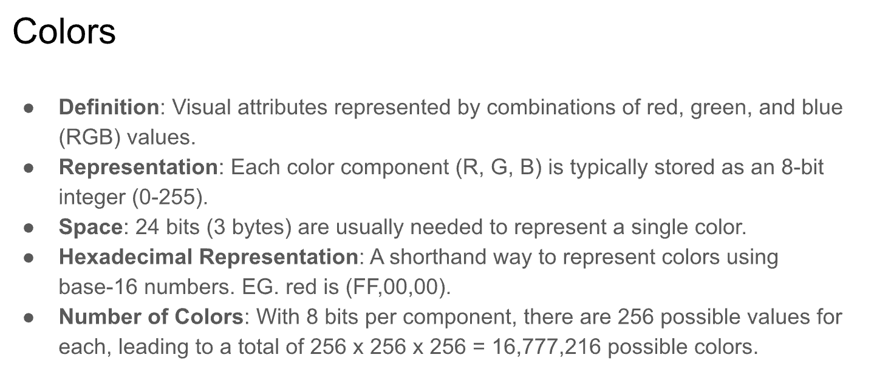

Slide 38
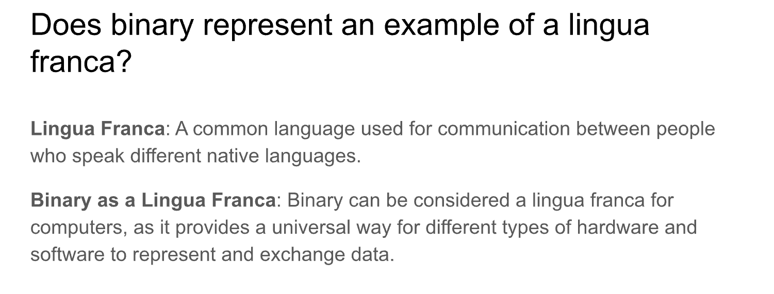

Slide 39
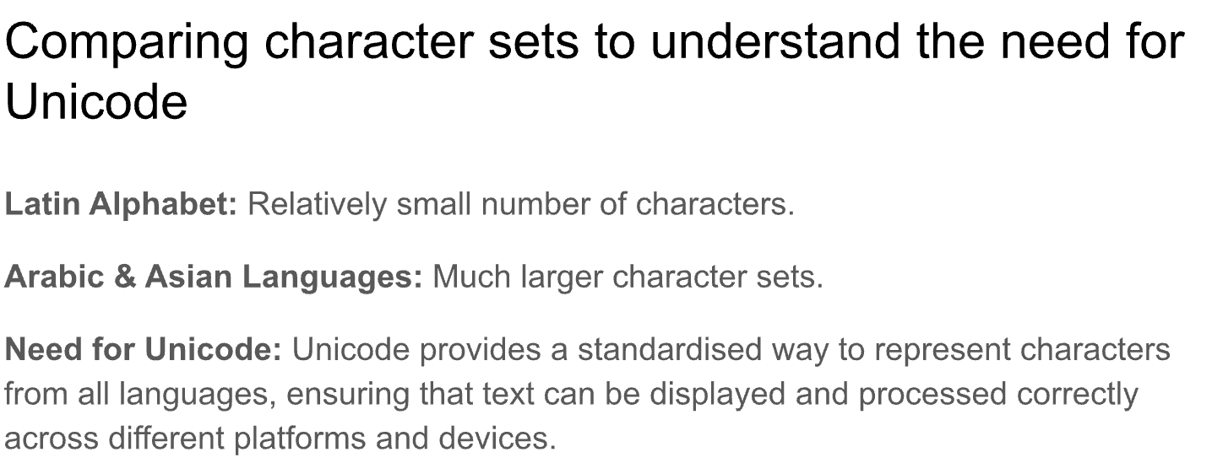

Slide 40
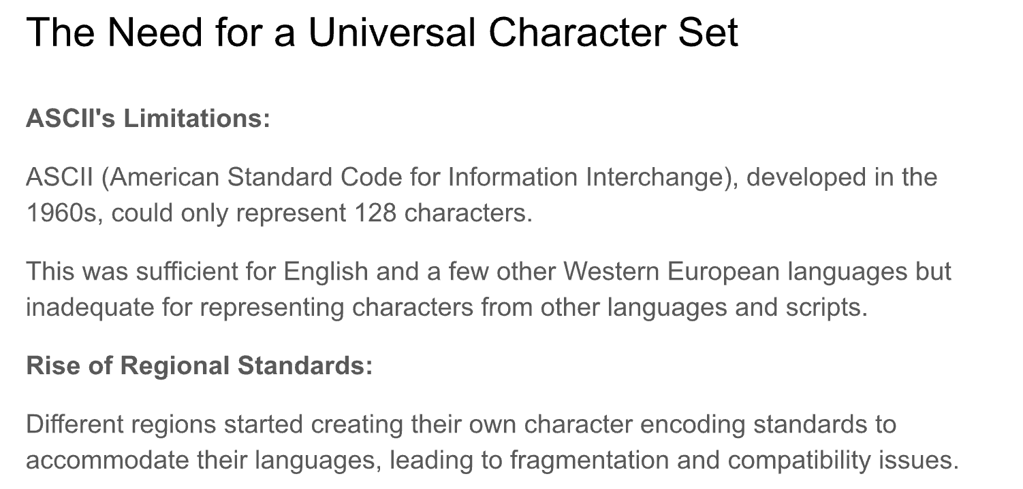

Slide 41
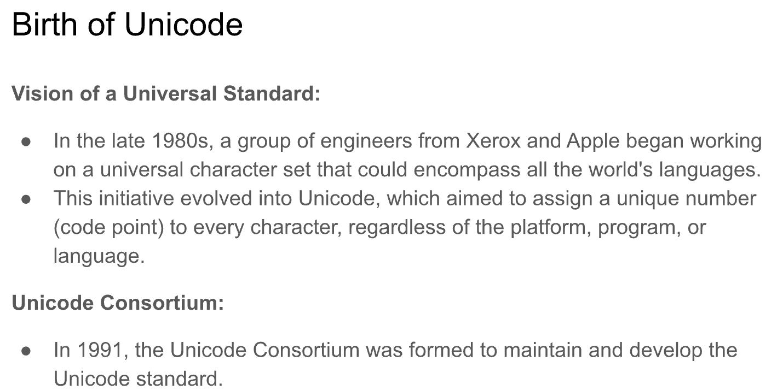

Slide 42
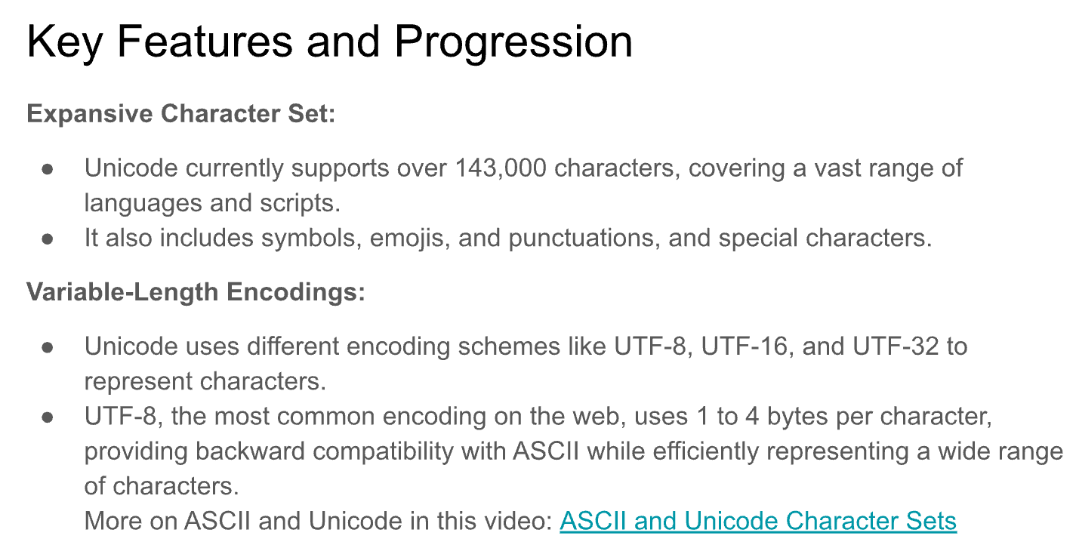
https://www.youtube.com/watch?v=I-pQH_krD0M

